Slide 1
Modeling Approach and Application to
Selected (4) Infrastructure Investments
Austin Miller
Eric Jessup
Freight Policy Transportation Institute
School of Economic Sciences
Washington State University
May 21, 2018

Slide 2
Agenda
Overview of possible modeling techniques
Description of current modeling approach
Network improvement effects
Localized construction impact
Overview of selected projects
Results and potential project rankings
Summary
Discussion

Slide 3
Modeling Network Investments
Network Design Models
Input-Output
Benefit-Cost Analysis
Regional Economic Models
Computable General Equilibrium
Modeling Techniques
Notes:
Eric’s analysis for network improvement effects
CGE analysis for regional effect of construction

Slide 4
Modeling Network Investments
Model Type | Description | Stakeholders | Data and/or Computational Needs
Network Design Models | Complex Simulation of Network Flows | Central Controller | High; New for each region
Benefit-Cost Analysis (BCA) | Comparison of Net-present Costs/Values; More General/Flexible | Often Single-agent Perspective | Relatively Low; Data needs depend on scope
Regional Economic Models (REM) | Simulation of Economic Activities | All Economic Agents, by sector | Medium; Data available for purchase (e.g., IMPLAN)
Notes:
Network- Europe/Belgium or BNSF; not encompass everything; new for each network; complicated because of multiple agents/owners (as per Suzette’s info)
BCA- When apply for grants, project proposers must do some kind of BCA: what to include, how to generate is not determined; generally not from perspective of entire supply chain

Slide 5
Regional Economic Modeling
Type of REM | Complexity | Model Includes | Outputs | Validity
Input-Output (IO) | Simpler: prices remain unchanged | Market Transactions, by Sectors | Employment, Incomes, Revenues, Sales | Tends to overestimate outcomes
Computable General Equilibrium (CGE) | More Complex: prices adjust to shocks | Market and non-Market Transactions, by Sectors, Institutions, and Input Factors | Same as I-O, plus household utility for real welfare changes | More accurate estimation; preferred when possible
Notes:
What is a SAM (industry transaction data, usually from tax records)
includes final sales as well as b2b and sales of intermediate goods (e.g., forest to lumber to construction to homes)

Slide 6
Current Analysis
Estimation of Supply Chain Impact
Location of investment within the supply chain
Type of improvement
Size of improvement
Affected modes
How it affects the competitive landscape (within and across modes)
Private money invested
System v. local improvements
Notes:
Number of shippers affected.

Slide 7
Current Analysis
Regional Economic Model of Construction Impacts
Modeling Software:
TranSight and PI+ from Regional Economic Models, Inc. (REMI)
TREDIS (the Transportation Economic Development Impact System) from Economic Development Research Group, Inc.
RIMS II (Regional Input-Output Modeling System) from the Bureau of Economic Analysis and the U.S. Department of Commerce
TELUS (the Transportation, Economic, and Land-Use System) from the Federal Highway Administration
SAM Data:
IMPLAN (MIG, Inc.)
Often integrated with proprietary software
Notes:
REM needs

Slide 8
Current Analysis
Regional Economic Model of Construction Impacts
Open-source CGE model
Developed by Leroy Stodick, David Holland, and Stephen Devadoss
Programmed in GAMS
Data from IMPLAN (county level)
Steps:
Select region of interest (counties near construction)
Setup base model from 2016 IMPLAN data
Shock model with investment
Model automatically readjusts and calculates welfare effects

Slide 9
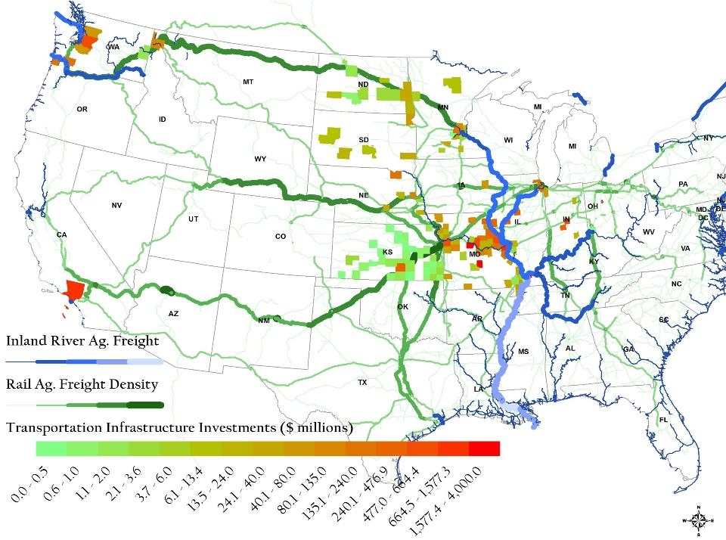
Summary
322 Projects, 138 Counties
$22.2 Billion
Many agencies (public, private)

Slide 10
Infrastructure Investments
Supporting Soybean Exports
Southern California Rail Project
Double Tracking and New Rail Bridges- Sandpoint, ID
BNSF
Merchants Bridge Replacement
Terminal Railroad Association of St. Louis (TRRA)
Olmsted Locks and Dam
USACE

Slide 11
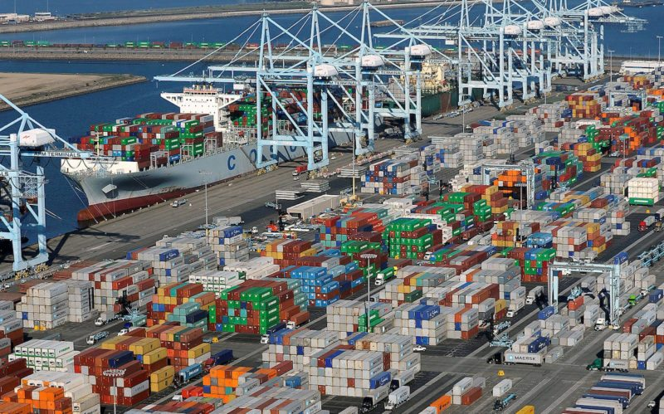
Project A: Southern California Rail Project
Notes:
The Ports of Los Angeles and Long Beach is the No. 6 U.S. Port for soybean exports
The Port of Los Angeles and Port of Long Beach moved 19% and 24% of the total U.S. waterborne containerized soybean exports
31% by rail, 48% by barge, and 20% by truck
California’s most congested highway network and most polluted air basin

Slide 12
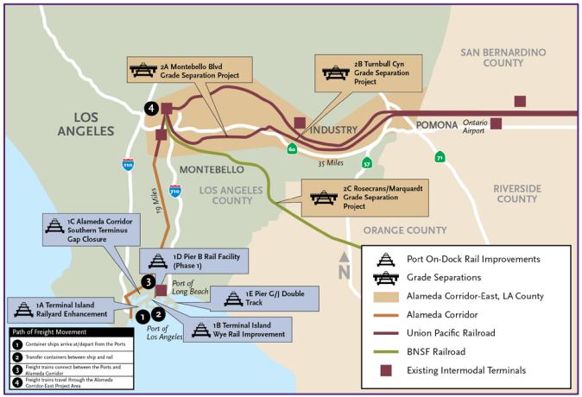
Project A: Southern California Rail Project
Notes:
The Ports of Los Angeles and Long Beach is the No. 6 U.S. Port for soybean exports
The Port of Los Angeles and Port of Long Beach moved 19% and 24% of the total U.S. waterborne containerized soybean exports
31% by rail, 48% by barge, and 20% by truck
California’s most congested highway network and most polluted air basin
Los Angeles County Metropolitan Transportation Authority (METRO)
Port of Los Angeles (POLA)
Port of Long Beach (POLB)
Alameda Corridor-East Construction Authority (ACECA).

Slide 13
Project A: Southern California Rail Project
8 Rail Projects (2019-2022)
5 at ports (POLA, POLB)
3 grade separations (ACECA, METRO)
Total Costs: $ 1.04 B
$ 184.64 M from State of California (TCEP)
$ 15.91 M from POLA
$ 556.17 M from POLB
$ 136.81 M from ACECA
$ 146.3 M from METRO
Notes:
8 Rail Projects (5 Port components; 3 grade separation components)
efficiency, safety, and reliability while reducing truck trips and vehicle emissions

Slide 14
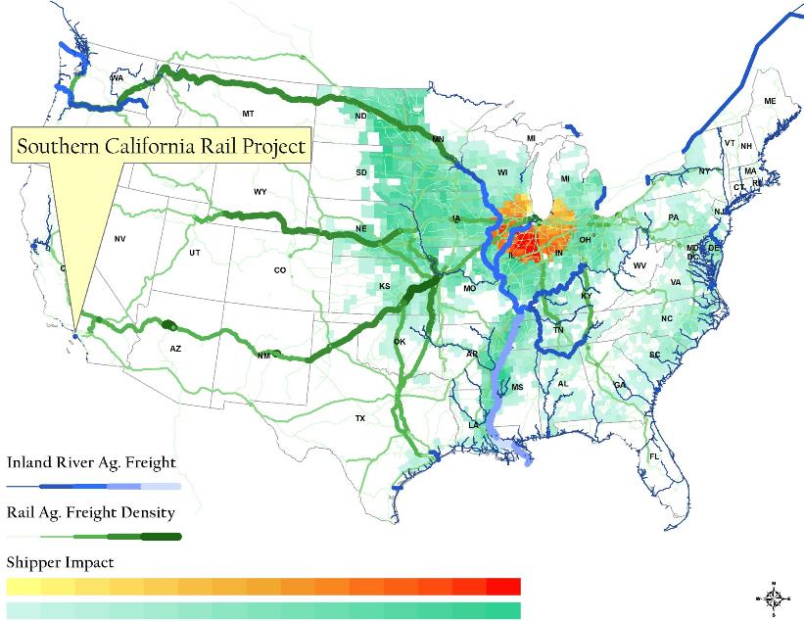
Project A: Southern California Rail Project
Content
Summary
Geographic region of impact primarily intermodal/container shipments within 100 miles of Chicago:
97 counties
496 Million Bu. of Production
Improved Capacity

Slide 15
Project A: Southern California Rail Project
Output Effects (millions of dollars)
 | Base | After Investment | Change
Agriculture | 862.52 | 863.13 | 0.61
Forestry | 9.14 | 9.14 | 0.00
Construction | 60,484.88 | 61,500.37 | 1,015.49
Utilities | 27,597.21 | 27,624.42 | 27.20
Wholesale/Retail | 156,176.17 | 156,472.50 | 296.33
Mining | 5,253.90 | 5,256.76 | 2.86
Processed Food | 29,961.98 | 29,987.99 | 26.01
Manufacturing | 195,710.14 | 195,938.20 | 228.06
Services | 911,743.21 | 912,520.32 | 777.11
Miscellaneous | 127,345.31 | 127,369.13 | 23.82
Total Change in Regional Output |  |  | 2,397.49
Notes:
Religious organizations
Social advocacy organizations
Labor and civic organizations
Owner-occupied dwellings
Used and secondhand goods
Scrap

Slide 16
Project A: Southern California Rail Project
Jobs Effects (number of annual FTE jobs)
 | Base | After Investment | Change
Agriculture | 255.92 | 256.28 | 0.36
Forestry | 0.48 | 0.48 | 0.00
Construction | 14,587.86 | 14,841.41 | 253.55
Utilities | 4,470.00 | 4,477.69 | 7.69
Wholesale/Retail | 51,031.69 | 51,149.47 | 117.78
Mining | 1,198.72 | 1,200.28 | 1.56
Processed Food | 3,676.74 | 3,681.66 | 4.92
Manufacturing | 39,203.05 | 39,268.85 | 65.80
Services | 256,036.43 | 256,420.36 | 383.93
Miscellaneous | 83,401.99 | 83,431.21 | 29.22
Total Change in Regional Jobs |  |  | 864.82
Notes:
Religious organizations
Social advocacy organizations
Labor and civic organizations
Owner-occupied dwellings
Used and secondhand goods
Scrap

Slide 17
Project A: Southern California Rail Project
Household Welfare Effects (millions of dollars)
 | Base | After Investment | Change
Agriculture | 2,204.63 | 2,206.96 | 2.34
Forestry | - | - | -
Construction | - | - | -
Utilities | 8,315.16 | 8,322.98 | 7.82
Wholesale/Retail | 65,935.02 | 66,000.30 | 65.28
Mining | 7.34 | 7.35 | 0.01
Processed Food | 23,800.65 | 23,824.60 | 23.95
Manufacturing | 51,534.43 | 51,590.72 | 56.29
Services | 295,912.74 | 296,168.99 | 256.25
Miscellaneous | 35,853.34 | 35,901.57 | 48.23
Total Change in Household Consumption |  |  | 460.16
Notes:
Religious organizations
Social advocacy organizations
Labor and civic organizations
Owner-occupied dwellings
Used and secondhand goods
Scrap

Slide 18
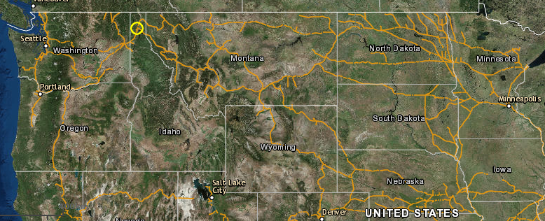
Project A: Double Tracking and New Rail
Bridges near Sandpoint, ID
BNSF Northern Line:
Notes:
BNSF Northern Line:
Connects Chicago to Portland
North Dakota oil and grain demand increase
Bottleneck at Sandpoint ( often referred to as the Spokane-Sandpoint “Funnel.”)
The current single-track bridge handles 50 to 60 trains per day. That figure can swell to nearly 70 trains per day during the end-of-year peak traffic season.
http://billingsgazette.com/news/state-and-regional/montana/montana-shippers-place-their-bets-on-bnsf-s-iron-horse/article_d9243fee-c181-5fc8-9ab2-2c00c0f8d558.html

Slide 19
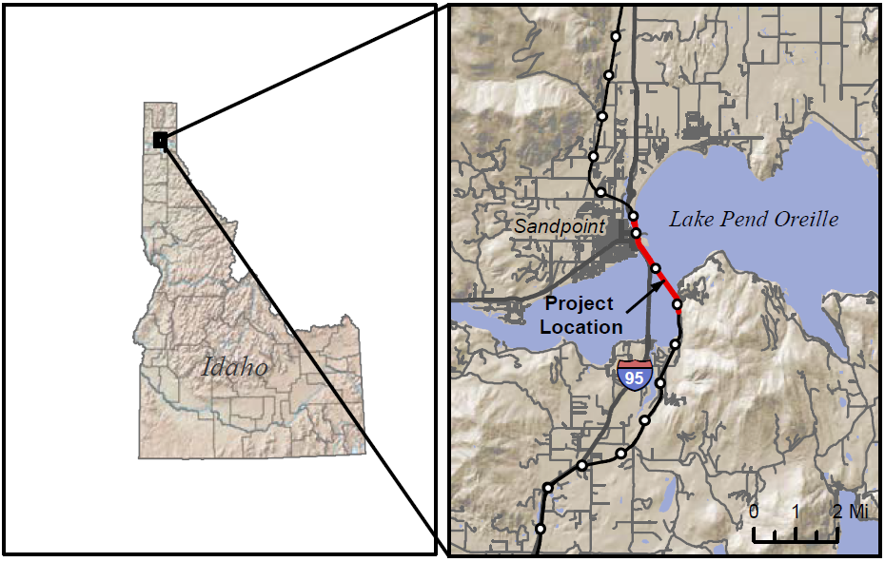
Project A: Double Tracking and New Rail
Bridges near Sandpoint, ID

Slide 20
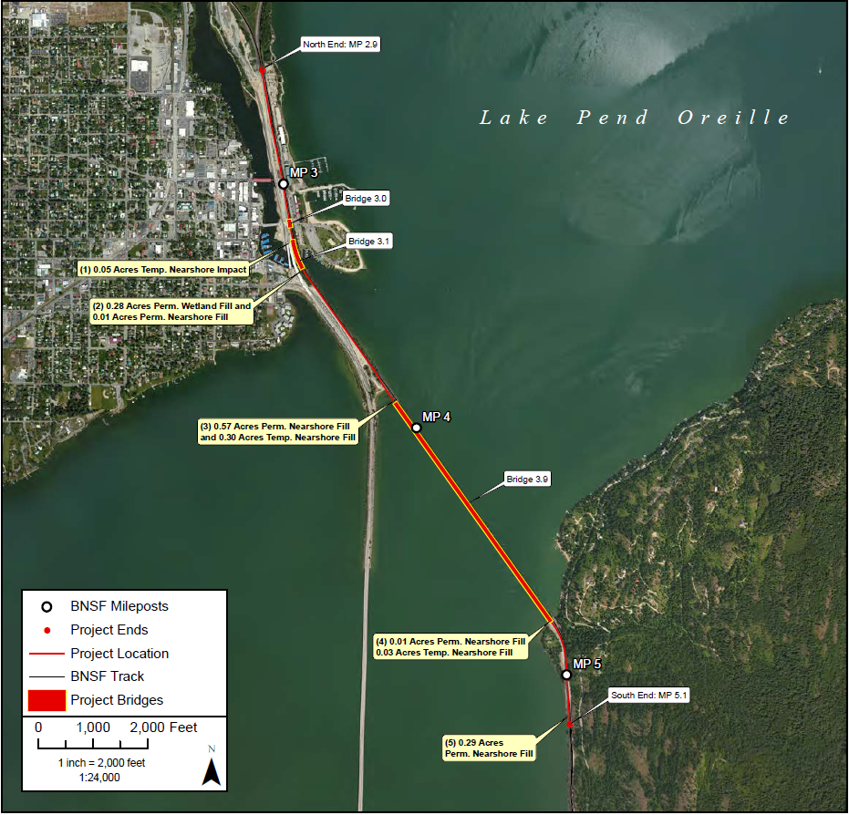
Project A: Double Tracking and New Rail
Bridges near Sandpoint, ID
Notes:
Second track from junction with Montana Rail Line at north to the siding track at the south
Second bridge adjacent to existing bridge
Two other bridges over Sand Creek and Bridge Street
http://www.nww.usace.army.mil/Portals/28/Users/115/07/1907/PN_NWW-2007-01303_Attachment_A.pdf?ver=2018-02-26-113459-207

Slide 21
Project A: Double Tracking and New Rail
Bridges near Sandpoint, ID
Double Tracking and New Bridges (2023)
12,000 feet of new mainline
Three new bridges
Total Costs: $129.7 M

Slide 22
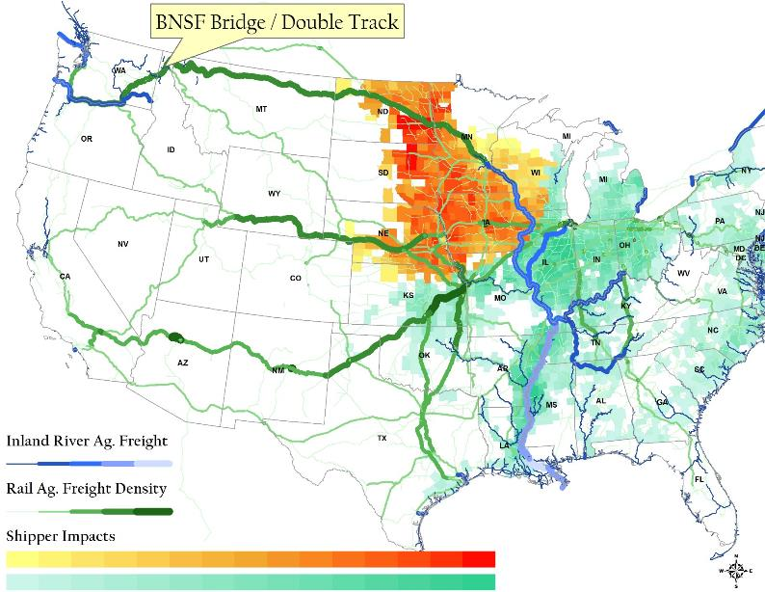
Project A: BNSF Double Track
Content
Summary
Geographic region of impact all soybean production headed to the PNW Export Market:
378 counties
1.638 Billion Bu. of Production
Improved Capacity

Slide 23
Project A: Double Tracking and New Rail
Bridges near Sandpoint, ID
Output Effects (millions of dollars)
 | Base | After Investment | Change
Agriculture | 460.5 | 459.4 | -1.1
Forestry | 161.0 | 160.8 | -0.2
Construction | 3,876.0 | 4,009.2 | 133.2
Utilities | 1,835.1 | 1,836.8 | 1.8
Wholesale/Retail | 6,907.3 | 6,933.3 | 25.9
Mining | 772.2 | 772.2 | 0.0
Processed Food | 1,356.5 | 1,356.2 | -0.3
Manufacturing | 9,227.8 | 9,217.6 | -10.2
Services | 30,161.8 | 30,213.3 | 51.5
Miscellaneous | 6,713.8 | 6,722.0 | 8.2
Total Change in Regional Output |  |  | 208.7
Notes:
Religious organizations
Social advocacy organizations
Labor and civic organizations
Owner-occupied dwellings
Used and secondhand goods
Scrap

Slide 24
Project A: Double Tracking and New Rail
Bridges near Sandpoint, ID
Jobs Effects (number of annual FTE jobs)
 | Base | After Investment | Change
Agriculture | 61.3 | 61.2 | 0.0
Forestry | 49.3 | 49.3 | 0.0
Construction | 749.2 | 775.9 | 26.7
Utilities | 216.6 | 217.1 | 0.5
Wholesale/Retail | 2131.2 | 2140.9 | 9.7
Mining | 142.4 | 142.6 | 0.2
Processed Food | 138.0 | 138.1 | 0.1
Manufacturing | 1370.1 | 1370.2 | 0.0
Services | 8099.8 | 8123.9 | 24.0
Miscellaneous | 4288.8 | 4296.7 | 7.9
Total Change in Regional Jobs |  |  | 69.1
Notes:
Religious organizations
Social advocacy organizations
Labor and civic organizations
Owner-occupied dwellings
Used and secondhand goods
Scrap

Slide 25
Project A: Double Tracking and New Rail
Bridges near Sandpoint, ID
Household Welfare Effects (millions of dollars)
 | Base | After Investment | Change
Agriculture | 145.2 | 145.4 | 0.2
Forestry | 0.0 | 0.0 | 0.0
Construction | 0.0 | 0.0 | 0.0
Utilities | 576.4 | 577.2 | 0.8
Wholesale/Retail | 4,149.9 | 4,156.5 | 6.6
Mining | 0.5 | 0.5 | 0.0
Processed Food | 1,583.3 | 1,585.8 | 2.5
Manufacturing | 3,211.6 | 3,217.3 | 5.6
Services | 18,413.5 | 18,440.5 | 27.0
Miscellaneous | 2,279.2 | 2,283.8 | 4.6
Total Change in Household Consumption |  |  | 47.3
Notes:
Religious organizations
Social advocacy organizations
Labor and civic organizations
Owner-occupied dwellings
Used and secondhand goods
Scrap

Slide 26
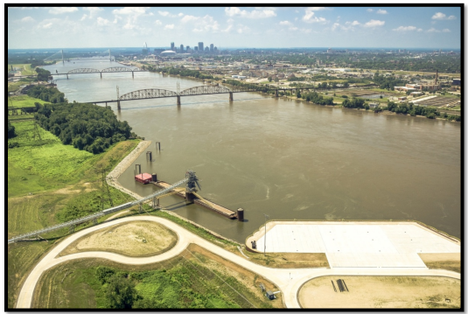
Project B: Merchants Bridge Replacement
Notes:
The 127-year-old Merchants Rail Bridge spans the Mississippi River between St. Louis, Missouri and Venice, Illinois and is owned by the Terminal Railroad Association of St. Louis (TRRA).
The Merchants Bridge links America’s eastern and western freight rail networks
carries more than 40 million gross tons annually; the busiest geographical crossing of the Mississippi River
serves six Class I railroads and Amtrak.
The St. Louis region is the second largest freight rail interchange location in the nation and third largest freight rail interchange location by tonnage.
Load restrictions prevent the crossing of two trains simultaneously, limiting the bridge to one track at all times.
Without renovation, the Merchants Rail Bridge could be taken out of service within ten years

Slide 27
Project B: Merchants Bridge Replacement
Upgrade Rail Bridge (2018-2021)
Removal and replacement of the three river-span trusses
Seismically retrofitting of the existing river piers
Improvement of the East approach
Total Costs: $ 213.9 M
$ 171.1 M from federal government
$ 42.8 M private financing
Notes:
Main: enable double-track capability
East approach: upgrade load capacity and clearance
Fed funding from INFRA and RRIF grants
Private: Terminal Railroad Association of St. Louis (TRRA)

Slide 28
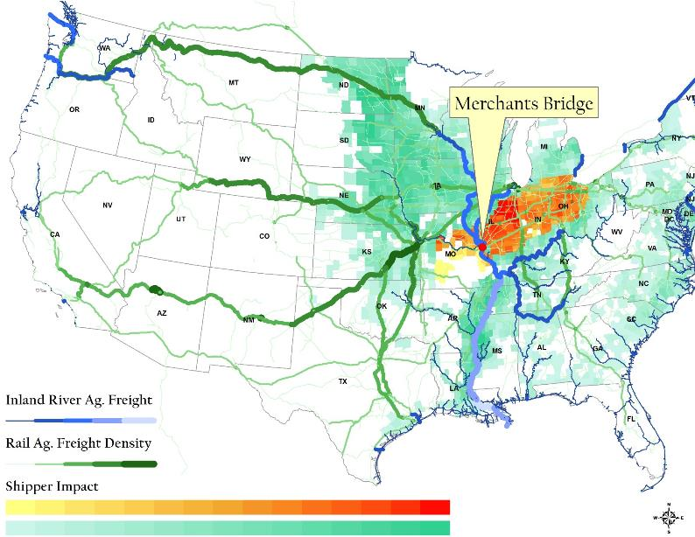
Project B: Merchants Bridge Replacement
Content
Summary
Geographic region of impact all soybean production upstream of outside of Ohio and Illinois River draw:
179 counties
817 Million Bu. of Production
Mitigating Failure
Improved Capacity

Slide 29
Project B: Merchants Bridge Replacement
Output Effects (millions of dollars)
 | Base | After Investment | Change
Agriculture | 1,573.3 | 1,570.6 | -2.7
Forestry | 55.2 | 55.1 | -0.1
Construction | 14,666.4 | 14,881.3 | 214.9
Utilities | 5,705.7 | 5,708.3 | 2.6
Wholesale/Retail | 29,130.2 | 29,167.0 | 36.8
Mining | 774.9 | 775.0 | 0.1
Processed Food | 9,606.2 | 9,600.9 | -5.3
Manufacturing | 67,089.8 | 67,060.3 | -29.5
Services | 162,814.2 | 162,912.6 | 98.5
Miscellaneous | 22,650.8 | 22,640.5 | -10.3
Total Change in Regional Output |  |  | 305.1
Notes:
Religious organizations
Social advocacy organizations
Labor and civic organizations
Owner-occupied dwellings
Used and secondhand goods
Scrap

Slide 30
Project B: Merchants Bridge Replacement
Jobs Effects (number of annual FTE jobs)
 | Base | After Investment | Change
Agriculture | 98.1 | 98.0 | -0.1
Forestry | 0.5 | 0.5 | 0.0
Construction | 3,917.5 | 3,976.1 | 58.6
Utilities | 609.6 | 610.2 | 0.6
Wholesale/Retail | 9,985.0 | 10,000.4 | 15.4
Mining | 122.9 | 122.9 | 0.1
Processed Food | 1,015.4 | 1,015.2 | -0.1
Manufacturing | 9,227.2 | 9,226.6 | -0.6
Services | 50,090.0 | 50,137.4 | 47.4
Miscellaneous | 13,720.9 | 13,715.5 | -5.5
Total Change in Regional Jobs |  |  | 115.8
Notes:
Religious organizations
Social advocacy organizations
Labor and civic organizations
Owner-occupied dwellings
Used and secondhand goods
Scrap

Slide 31
Project B: Merchants Bridge Replacement
Household Welfare Effects (millions of dollars)
 | Base | After Investment | Change
Agriculture | 541.4 | 541.7 | 0.3
Forestry | 0.0 | 0.0 | 0.0
Construction | 0.0 | 0.0 | 0.0
Utilities | 2,087.8 | 2,089.1 | 1.3
Wholesale/Retail | 15,843.5 | 15,853.6 | 10.1
Mining | 1.8 | 1.8 | 0.0
Processed Food | 5,865.7 | 5,869.3 | 3.6
Manufacturing | 12,351.6 | 12,360.0 | 8.5
Services | 70,890.6 | 70,935.5 | 44.8
Miscellaneous | 8,673.1 | 8,680.0 | 6.9
Total Change in Household Consumption |  |  | 75.6
Notes:
Religious organizations
Social advocacy organizations
Labor and civic organizations
Owner-occupied dwellings
Used and secondhand goods
Scrap

Slide 32
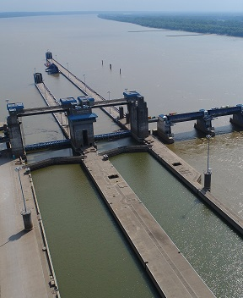
Project C: Olmsted Locks and Dam
Notes:
In Pulaski County, Illinois, and Ballard County, Kentucky, on the Ohio River near Olmsted, Illinois
Approximately 964 miles downstream from Pittsburgh, Pennsylvania
About 17 miles upstream from the confluence of the Ohio and Mississippi rivers
Locks and Dam Nos. 52 and 53 have each averaged approx. 80 million tons worth of bulk commodities (built in 1929)
More tonnage passes through this point than any other place in America’s inland navigation system.

Slide 33
Project C: Olmsted Locks and Dam
Replace Locks and Dam 52 and 53 (2018-2020)
Two 110’x 1200’ locks
A wicket dam that can be raised or lowered according to river flows
Total Costs: $2.7 B
Notes:
Will replace Ohio River Locks and Dams 52 and 53.
Reduce tow and barge delays through the busiest stretch of river in America's inland waterways.

Slide 34
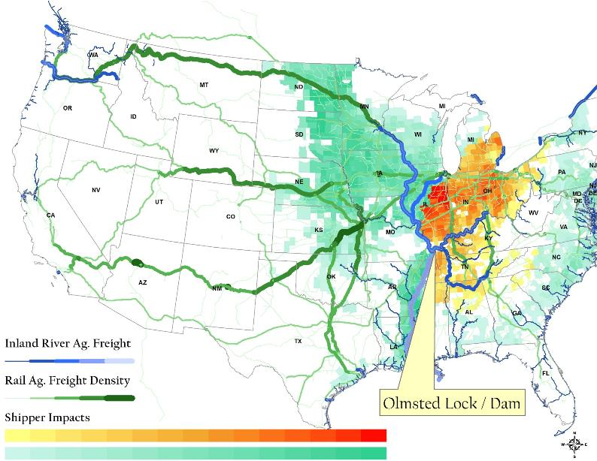
Project C: Olmsted Locks and Dam
Summary
Geographic region of impact all soybean production upstream of Olmstead Lock:
435 counties
1.117 Billion Bu. of Production
Mitigating Failure
Improved Capacity
Content

Slide 35
Project C: Olmsted Locks and Dam
Output Effects (millions of dollars)
 | Base | After Investment | Change
Agriculture | 1,686.6 | 1,355.2 | -331.5
Forestry | 21.0 | 19.6 | -1.4
Construction | 1,972.4 | 4,518.7 | 2,546.3
Utilities | 2,294.4 | 2,336.9 | 42.5
Wholesale/Retail | 3,888.7 | 4,347.1 | 458.5
Mining | 626.6 | 602.1 | -24.5
Processed Food | 2,011.0 | 1,802.7 | -208.3
Manufacturing | 5,613.0 | 5,622.3 | 9.3
Services | 17,561.3 | 18,395.5 | 834.1
Miscellaneous | 3,913.9 | 4,056.4 | 142.5
Total Change in Regional Output |  |  | 3,467.4
Notes:
Religious organizations
Social advocacy organizations
Labor and civic organizations
Owner-occupied dwellings
Used and secondhand goods
Scrap

Slide 36
Project C: Olmsted Locks and Dam
Jobs Effects (number of annual FTE jobs)
 | Base | After Investment | Change
Agriculture | 95.9 | 80.3 | -15.6
Forestry | 0.6 | 0.7 | 0.1
Construction | 362.3 | 854.7 | 492.4
Utilities | 240.0 | 253.3 | 13.3
Wholesale/Retail | 1,189.9 | 1,358.3 | 168.4
Mining | 79.7 | 79.6 | -0.1
Processed Food | 189.3 | 173.8 | -15.4
Manufacturing | 798.0 | 822.6 | 24.7
Services | 4,468.6 | 4,822.1 | 353.6
Miscellaneous | 2,588.5 | 2,720.8 | 132.4
Total Change in Regional Jobs |  |  | 1,153.5
Notes:
Religious organizations
Social advocacy organizations
Labor and civic organizations
Owner-occupied dwellings
Used and secondhand goods
Scrap

Slide 37
Project C: Olmsted Locks and Dam
Household Welfare Effects (millions of dollars)
 | Base | After Investment | Change
Agriculture | 81.3 | 84.1 | 2.8
Forestry | 0.0 | 0.0 | 0.0
Construction | 0.0 | 0.0 | 0.0
Utilities | 327.3 | 340.5 | 13.2
Wholesale/Retail | 2,288.6 | 2,397.3 | 108.6
Mining | 0.3 | 0.3 | 0.0
Processed Food | 890.7 | 931.4 | 40.6
Manufacturing | 1,758.9 | 1,852.5 | 93.6
Services | 10,157.5 | 10,617.6 | 460.2
Miscellaneous | 1,256.9 | 1,334.1 | 77.2
Total Change in Household Consumption |  |  | 796.2
Notes:
Religious organizations
Social advocacy organizations
Labor and civic organizations
Owner-occupied dwellings
Used and secondhand goods
Scrap

Slide 38
How to Rank these 4 different infrastructure projects?
Southern California Rail Project
Double Tracking and New Rail Bridges- Sandpoint, ID
BNSF
Merchants Bridge Replacement
Terminal Railroad Association of St. Louis (TRRA)
Olmsted Locks and Dam
USACE
Notes:
Will replace Ohio River Locks and Dams 52 and 53.
Reduce tow and barge delays through the busiest stretch of river in America's inland waterways.

Slide 39
Summary and Example Rankings
 | Type of Improvement | Network Effects | Affected Modes | Private Investment | System v. Local | Construction Impacts
CA Rail Project | Expand Capacity/Efficiency/Safety | 97 counties; 496 M Bu. | Intermodal Rail | $ M | Container Exports | O: $2,397 M J: $864 M HH: $460 M
Sandpoint BNSF Project | Expand Capacity | 378 counties; 1,638 M Bu. | Rail | $129.7 M | Northern Corridor | O: $208.7 M J: $69.1 M HH: $47.3 M
Merchants Bridge | Expand Capacity; Mitigate Failure | 179 counties; 817 M Bu. | Rail | $42.8 M | Support East-West Crossings | O: $305.1 M J: $115.8 M HH: $75.6 M
Olmsted Locks and Dam | Expand Capacity; Mitigate Failure | 435 counties; 1,117 M Bu. | Barge | $0 | Ohio River | O: $3,467.4 M J: $1,153.5 M HH: $796.2 M
Notes:
Network Effects: Location/Size of Improvement (in this case, capacity improvement)
Here is the summary of the impact of each project.
Ranking will depend on the weights given to each aspect/outcome of the improvement.

Slide 40
Regional Economic Impact
 | Type of Improvement | Network Effects | Rank | Private Investment | System v. Local | Construction Impacts
Olmsted Locks and Dam | Expand Capacity; Mitigate Failure | 435 counties; 1,117 M Bu. | 1st | $0 | Ohio River | O: $3,467.4 M J: $1,153.5 M HH: $796.2 M
CA Rail Project | Expand Capacity/Efficiency/Safety | 97 counties; 496 M Bu. | 2nd | $0 | Container Exports | O: $2,397 M J: $864 M HH: $460 M
Merchants Bridge | Expand Capacity; Mitigate Failure | 179 counties; 817 M Bu. | 3th | $42.8 M | Support East-West Crossings | O: $305.1 M J: $115.8 M HH: $75.6 M
Sandpoint BNSF Project | Expand Capacity | 378 counties; 1,638 M Bu. | 4rd | $129.7 M | Northern Corridor | O: $208.7 M J: $69.1 M HH: $47.3 M
Notes:
Network Effects: Location/Size of Improvement (in this case, capacity improvement)
Here is the summary of the impact of each project.
Ranking will depend on the weights given to each aspect/outcome of the improvement.

Slide 41
Shipper / Network Impacts
 | Type of Improvement | Network Effects | Rank | Private Investment | System v. Local | Construction Impacts
Olmsted Locks and Dam | Expand Capacity; Mitigate Failure | 435 counties; 1,117 M Bu. | 1st | $0 | Ohio River | O: $3,467.4 M J: $1,153.5 M HH: $796.2 M
Sandpoint BNSF Project | Expand Capacity | 378 counties; 1,638 M Bu. | 2rd | $129.7 M | Northern Corridor | O: $208.7 M J: $69.1 M HH: $47.3 M
Merchants Bridge | Expand Capacity; Mitigate Failure | 179 counties; 817 M Bu. | 3th | $42.8 M | Support East-West Crossings | O: $305.1 M J: $115.8 M HH: $75.6 M
CA Rail Project | Expand Capacity/Efficiency/Safety | 97 counties; 496 M Bu. | 4nd | $0 | Container Exports | O: $2,397 M J: $864 M HH: $460 M
Notes:
Network Effects: Location/Size of Improvement (in this case, capacity improvement)
Here is the summary of the impact of each project.
Ranking will depend on the weights given to each aspect/outcome of the improvement.

Slide 42
Private Investment
 | Type of Improvement | Network Effects | Rank | Private Investment | System v. Local | Construction Impacts
Sandpoint BNSF Project | Expand Capacity | 378 counties; 1,638 M Bu. | 1rd | $129.7 M | Northern Corridor | O: $208.7 M J: $69.1 M HH: $47.3 M
Merchants Bridge | Expand Capacity; Mitigate Failure | 179 counties; 817 M Bu. | 2th | $42.8 M | Support East-West Crossings | O: $305.1 M J: $115.8 M HH: $75.6 M
CA Rail Project | Expand Capacity/Efficiency/Safety | 97 counties; 496 M Bu. | 3nd | $0 | Container Exports | O: $2,397 M J: $864 M HH: $460 M
Olmsted Locks and Dam | Expand Capacity; Mitigate Failure | 435 counties; 1,117 M Bu. | 4st | $0 | Ohio River | O: $3,467.4 M J: $1,153.5 M HH: $796.2 M
Notes:
Network Effects: Location/Size of Improvement (in this case, capacity improvement)
Here is the summary of the impact of each project.
Ranking will depend on the weights given to each aspect/outcome of the improvement.

Slide 43
Effects not Captured
Environmental effects (energy, emissions, life-cycle)
Safety (accidents)
Road congestion (travel time) and pavement damage
Regional economic effects of network improvement
Notes:
Competition within and across modes
Location in the supply chain

Slide 44
Feedback
Applied within your organization?
Improved upon? How?
Resources to maintain and update?
Result in more efficient and effective infrastructure investments?
Notes:
Competition within and across modes
Location in the supply chain

