Slide 1

Mastering Maritime Cybersecurity: A Discussion of the New USCG Regulation
May 29, 2025

Slide 2
The views and opinions expressed by the panelists during this discussion are their own. These perspectives do not necessarily reflect the official policies or positions of the U.S. Coast Guard, Universal Strategy Group, Inc., Coruscant Productions, Jones Walker LLP, or any other organization with which the panelists are affiliated. This session is intended for informational and discussion purposes
The information described in this program is general in nature, and may not apply to your specific situation.
Legal advice should be sought before taking action based on the information discussed. No attorney-client relationship is formed merely by your attendance at this event.

Slide 3


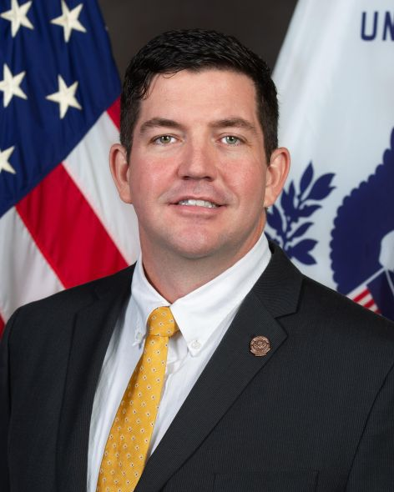
Andrew R. Lee, CIPP/US Partner & Privacy, Data Strategy, and Artificial Intelligence Team Co-leader Jones Walker LLP | T. Gwyddon “Data” Owen Director of Cyber and Technology USGI | Nick Parham MTS Cybersecurity Coordinator US Coast Guard’s Atlantic Area Command

Slide 4
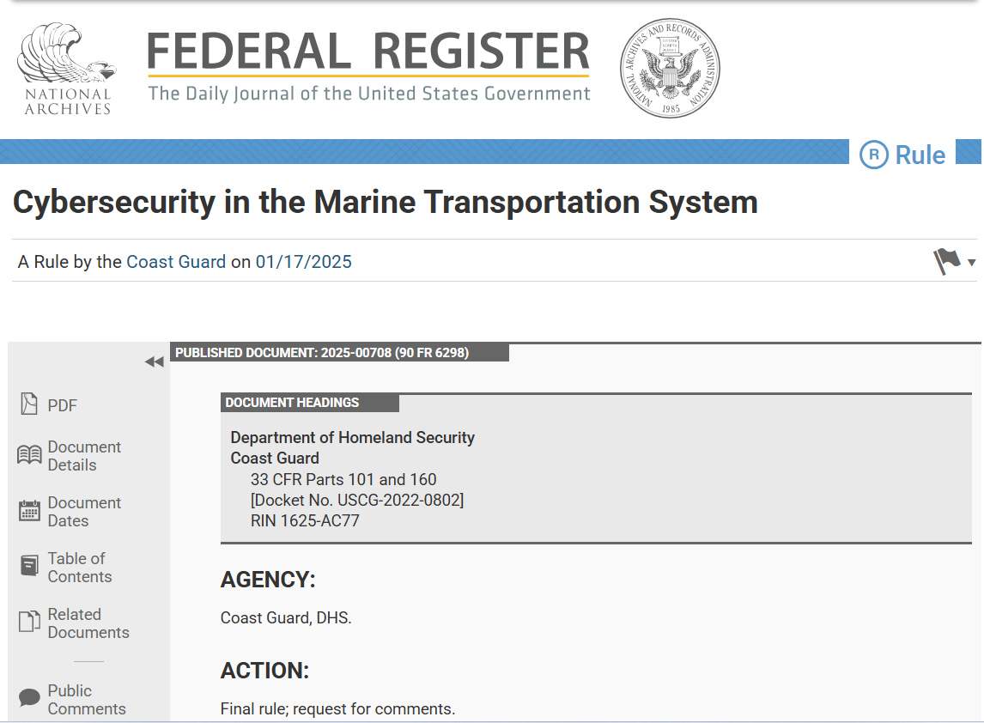

Slide 5


Slide 6
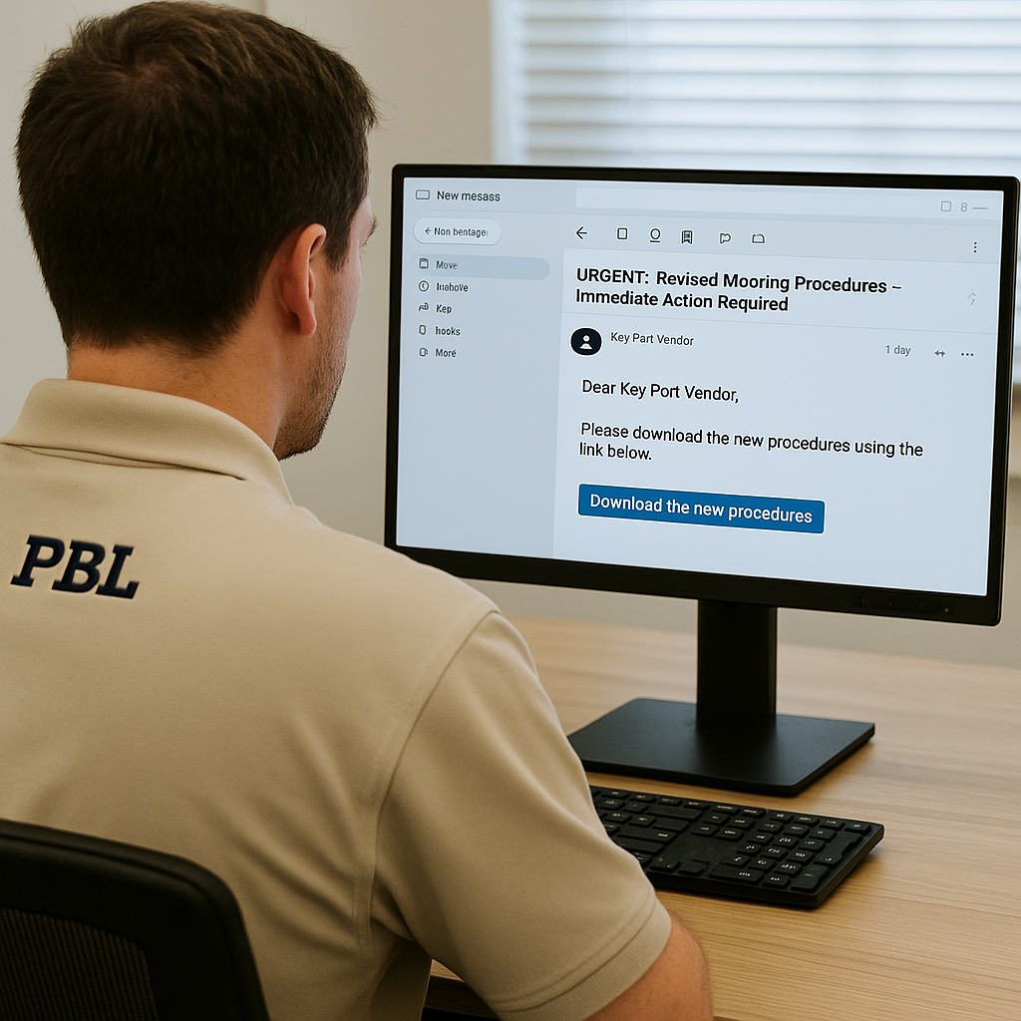

Slide 7
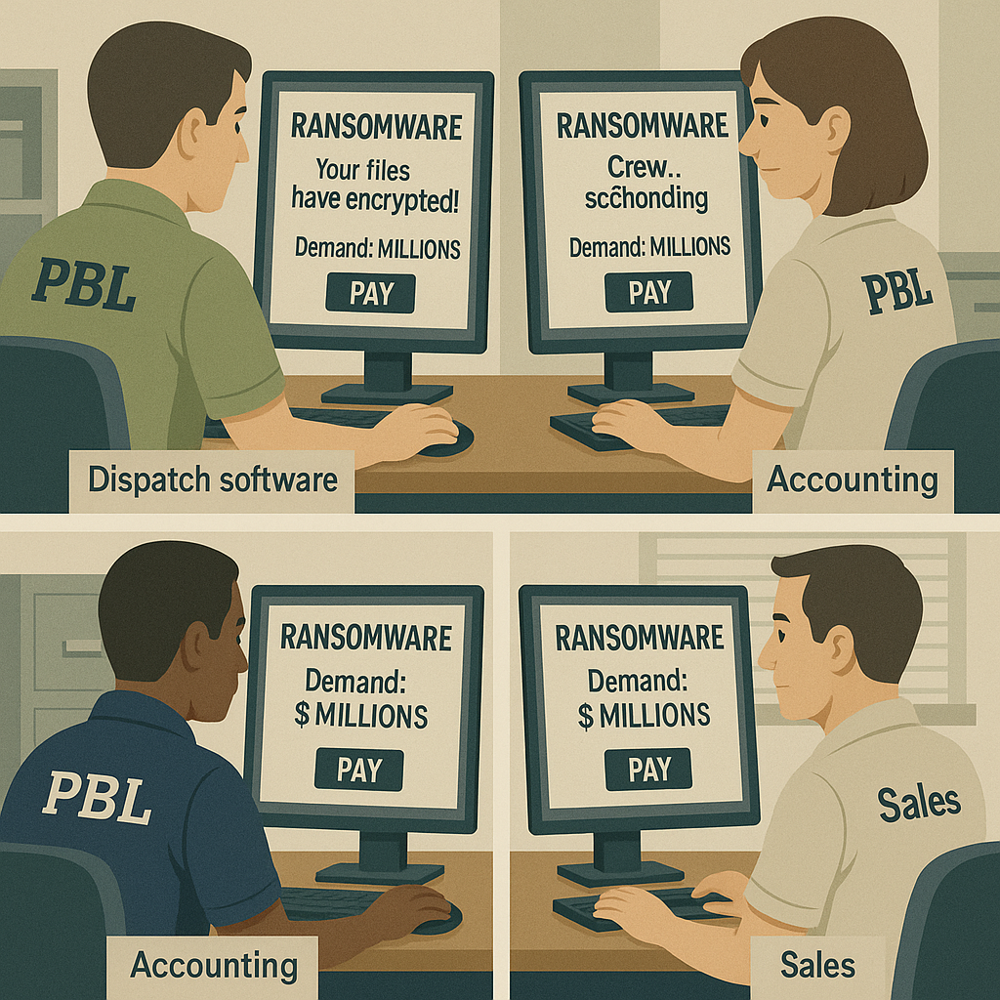

Slide 8
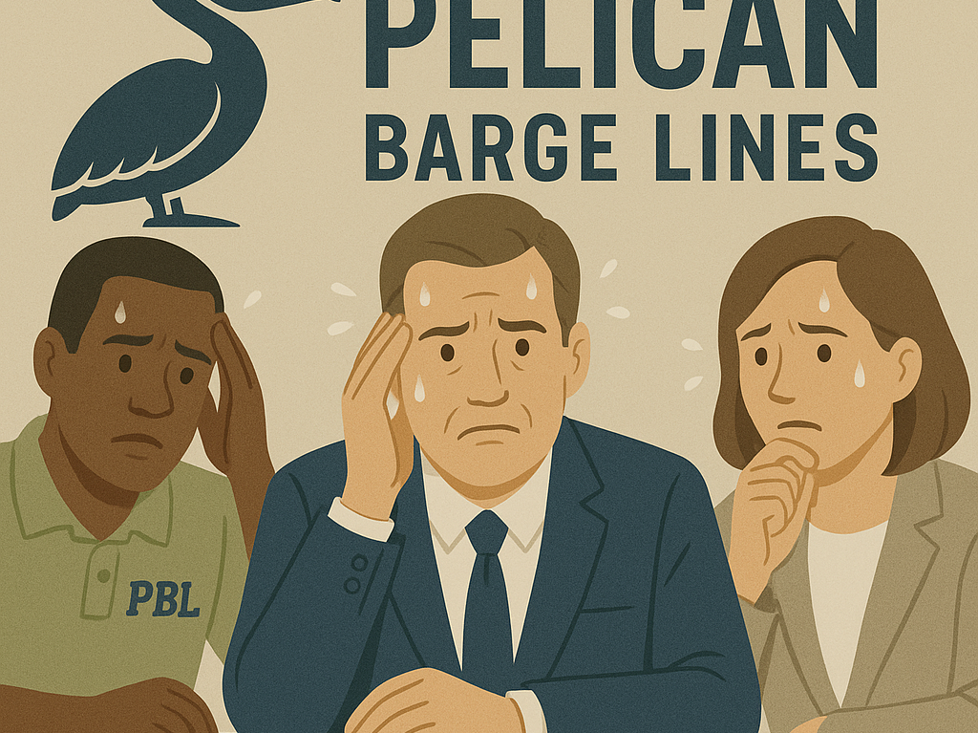

Slide 9
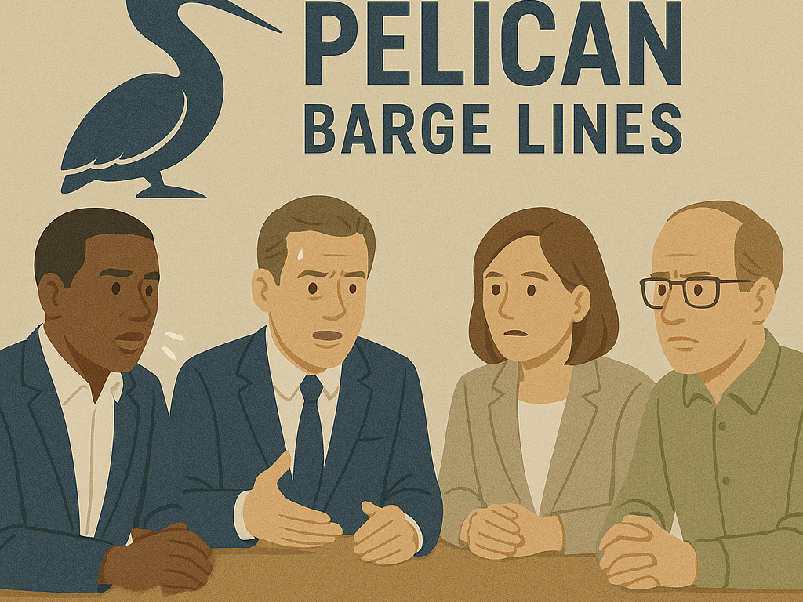

Slide 11
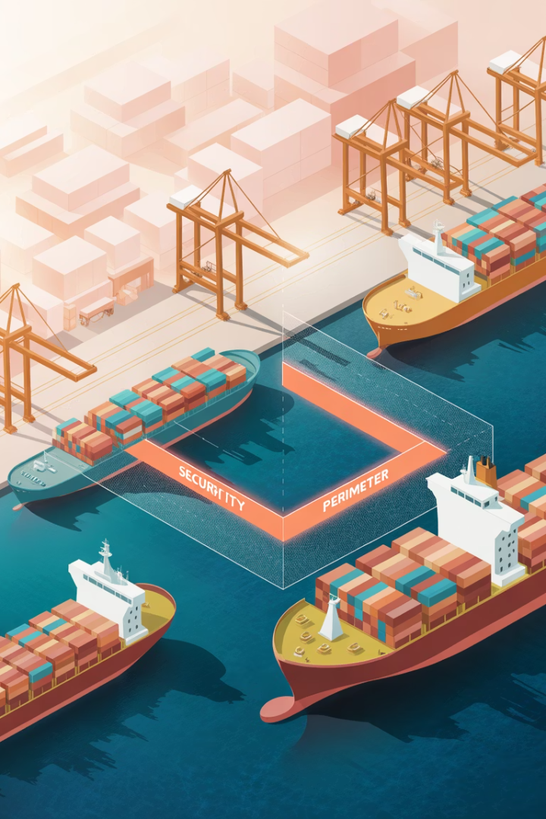




Rule Overview & Applicability
Rule Goal
Minimize cybersecurity-related Transportation Security Incidents in the Marine Transportation System.
Effective Date
July 16, 2025
Who Is Affected
U.S.-flagged vessels, OCS facilities, and MTSA facilities required to have security plans.
Exclusions
Does NOT apply to foreign-flagged vessels subject to 33 CFR part 104.

Slide 12










Core Requirements
Cybersecurity Plan
Mandatory plan including account, device, and data security measures
Cybersecurity Officer
Designated individual responsible for implementation and oversight
Assessments & Testing
Identify vulnerabilities and conduct penetration testing
Training & Drills
Personnel training, two drills and one exercise annually
Incident Reporting
Report cyber incidents to NRC without delay

Slide 13
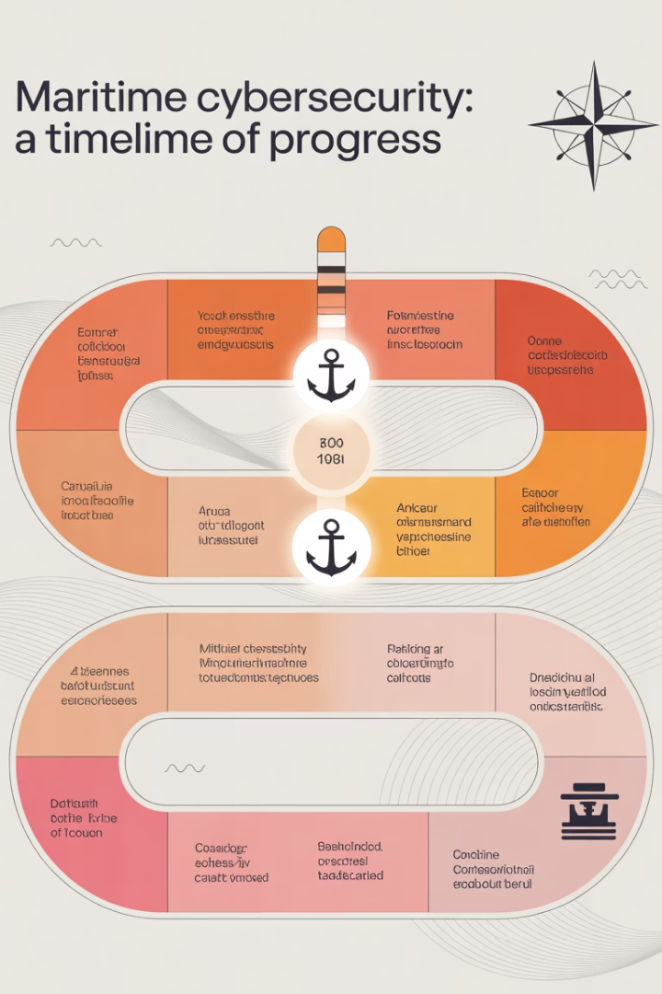




Key Compliance Deadlines
July 16, 2025
Begin reporting cyber incidents to NRC
January 12, 2026
Complete initial personnel and key personnel training
July 16, 2027
Designate CySO, conduct assessment, submit plan for approval
After Plan Approval
Conduct drills/exercises; additional training within 60 days

Slide 14

The Maritime Cyber Threat Landscape
Increasing Digital Connectivity
Sophisticated Adversaries
Rapid adoption of interconnected IT and OT systems creates expanded attack surfaces.
Nation-state actors and criminal groups target maritime infrastructure daily.
Attack Vectors
Potential Impacts
Phishing (71% of initial access) and valid accounts (42% of MTS incidents) are primary vectors.
Navigation disruption, cargo control compromise, safety risks, and economic damage.

Slide 15





First Steps Toward Compliance
Start Now
Don't wait for deadlines. Begin preparation immediately.
CySO Evaluation
Assess internal capabilities or outsourcing needs for this role.
System & Data Inventory
Identify critical IT/OT systems and sensitive data locations.
Gap Analysis
Compare existing security measures against rule requirements.

Slide 16
Regulatory Flexibility
Performance-Based Approach
Waivers Available
Equivalence Determinations
Owners can request waivers for specific requirements if deemed unnecessary given operating conditions. Must submit written justification.
Alternative measures can be proposed if they meet or exceed the effectiveness of required measures.
The rule focuses on security outcomes rather than specific technical solutions. This gives operators flexibility in implementation methods.

Slide 17

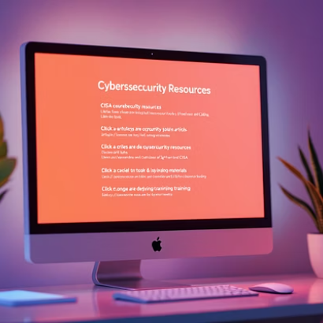

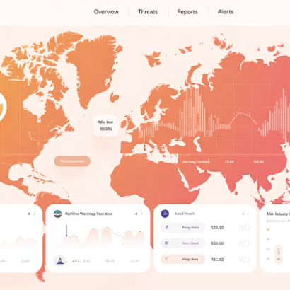
Resources & Collaboration
Leverage Coast Guard experts (uscg.mil/MaritimeCyber), CISA's Cyber Hygiene Services, industry partnerships, and Information Sharing and Analysis Centers (ISACs).

Slide 18
QUESTIONS?
May 29, 2025

