Slide 1
Inland Waterways: Challenges and Opportunities Tracy Zea President/CEO, WCI 5-29-25

Slide 2
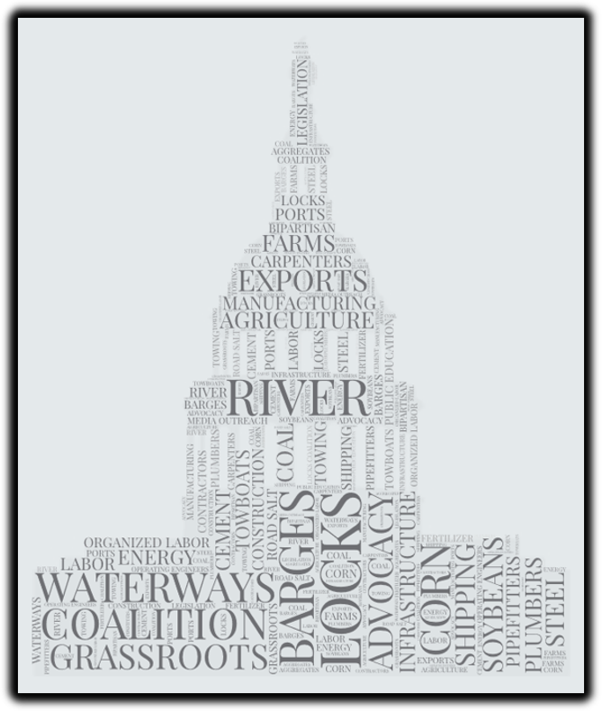
Who is Waterways Council, Inc. (WCI)?
Mission: To advocate for a modern, efficient and well-maintained inland waterways transportation system
Five employees
Three office locations
One contract lobbying firm
Van Scoyoc Associates
Approximately 185 diverse members

Slide 4
Over the last 11 years, WCI has secured
$2.2 billion in additional appropriations, and $2.9 billion in supplemental funding for a total of an additional $5.1 billion
Inland Waterways Construction Funding

Slide 5
Challenges Ahead

Slide 6
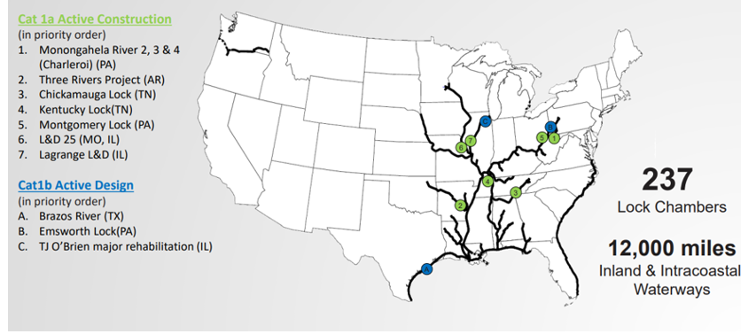
Active Construction/Design Projects Locations

Slide 7
Cost Overruns and Schedule Slippages
Project | Year Authorized | Authorized Cost | 1st Year of Construction $ | Current Estimated Cost | Percentage Increase | Date Operational
Lower Mon 2,3, 4 | 1992 | $556.4 million | FY 1995 | $1.23 billion | 121.6% | December, 2024
Kentucky Lock | 1996 | $393.2 million | FY 1999 | $1.56 billion | 297% | July, 2029
Chickamauga Lock | 2003 | $267.2 million | FY 2004 | $954.4 million | 257.2% | November, 2027
MKARNS 12-Foot Channel | 2004 | $158.4 million | FY 2009 | $1.02 Billion | 543.9% | TBD
L/D 25 | 2007 | $626 million | FY 22 (IIJA) | $2.26 Billion | 261% | October, 2034
Montgomery | 2016 | $782.2 million | FY 22 (IIJA) | $1.69 billion | 116.1% | October, 2032
Three Rivers | 2018 | $184.4 million | FY 22 (IIJA) | $333.7 million | 80.9% | September, 2026
GIWW – Brazos | 2020 | $158.1 million | TBD | $260 million* | 64% | TBD

Slide 8
KY Lock is now a bigger disaster than Olmsted
Project | Authorized Cost/Start Year | Total Cost | Percentage +/- | Years to Construct
Olmsted Locks and Dam | $775 million/ 1992 | $2.9 billion | 275% | 26
KY Lock | $393.2 million/ 1999 | $1.56 billion* | 297%* | 26, and ongoing*

Slide 9
Significant Risk Ahead…
Previous Trump Administration
Tried to restructure the Corps (DOT & DOI)
Department of Government Efficiency (DOGE)
Goal: $2 trillion in savings/cuts
Committees:
House: Oversight and Government Reform (Comer)
Senate: DOGE Caucus (Ernst)

